Slide 1
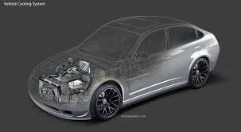
THE COOLING SYSTEM

Slide 2
PURPOSE
To regulate the engine internal temperature
To remove excess heat from engine
To provide heat to the passenger compartment
During the combustion of air fuel mixture the temperature as high as 2500 degreeC may be reached by burning gases.
The temperature is so high as it will break the lubrication system.
This temperature must be reduce by some mean to such a value , about 200C to 250C
The purpose of cooling system to reduce the temperature of engine

Slide 3
Types of cooling system
Air cooling system
Water cooling or liquid system

Slide 4
Air cooling
Air cooling system is the simplest method of cooling engines.
The engine being cooled will have a flow of air moving over its surface.
Many motorcycles uses air cooling for the sake of reducing weight and complexity.
Surface area of metal in contact with air.
Rate of air flow.
Temperature difference between the heated surface and the air.

Slide 5
Advantage and Disadvantage of air cooled engine
Advantage
disadvantage
Light in weight
No topping up the cooling system
No leaks to guard against
Anti freeze not requird
Less efficient cooling
Not easy to maintain even cooling all around the cylinder.
More noisy operation
Limited use in motorcycle

Slide 6
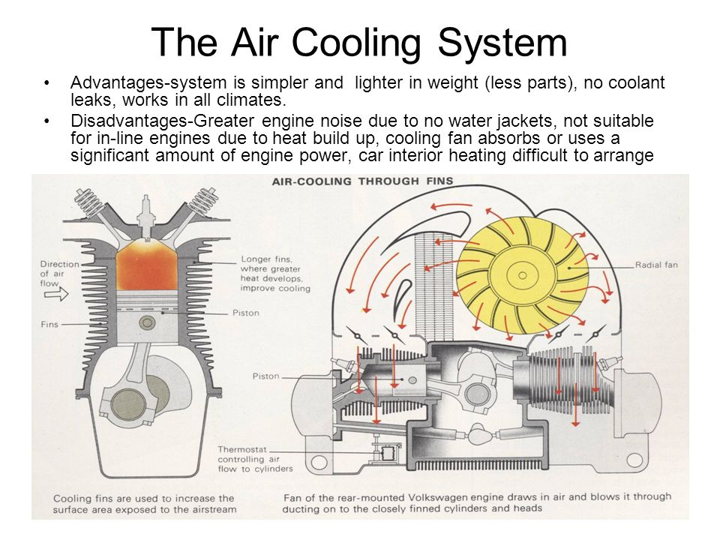
Major component of air cooling system

Slide 7
Working of air cooling system
A cylinder from an air-cooled aviation engine, a Continental C85. Notice the rows of fins on both the steel cylinder barrel and the aluminum cylinder head. The fins provide additional surface area for air to pass over the cylinder and absorb heat

Slide 8
Water cooling system
Water cooling is commonly used for cooling automobile internal combustion engine.
Water cooling is method heat removal from components.
In this method of cooling water is circulated through water jacket around each of the combustion chamber.
The circulating water when passes through the engine.

Slide 9
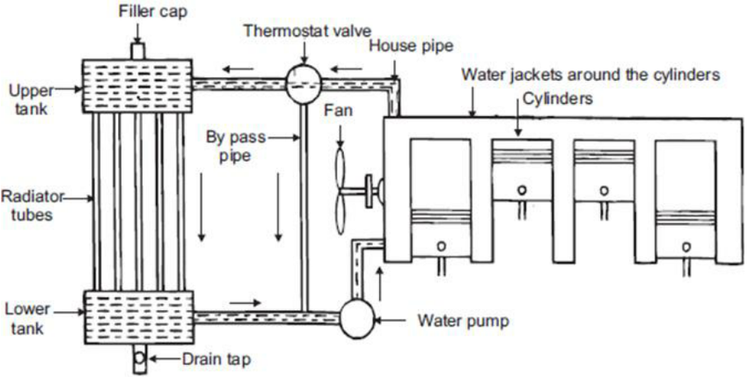
Working of water cooling system

Slide 10
Major components of water cooling system
Radiators
Thermostat
Water pump
Fan
Pressure cap
Water jackets
Antifreeze solutions

Slide 11
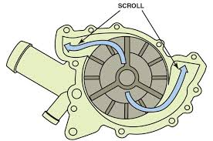
THE WATER PUMP
Centrifugal type rotates than crank up to 10,000 gal. per hour
Pulley driven, belt , chain drive or direct drive

Slide 12
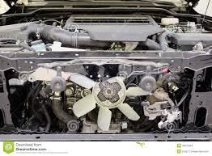
The cooling fan
Provide air flow with vehicle stopped
Belt driven or electric
Provides increased air flow at low RPM or vehicles

Slide 13
The radiator
Transfer heat from coolant to the atmosphere
Two types- vertical and cross flow
Aluminium ,brass, copper core, brass, copper or plastic tanks.

Slide 14
Working of radiator
Radiator is a device having a large amount of cooling surface to the large amount of air so that the water circulating through it is cooled efficently.
It consists of a uper tank and lower tank and a core between them.
The upper tank is connected to the water tank and lower is connected to the jacket inlet.
The core is a radiating element , which cools the water.

Slide 15
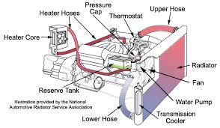
How a Radiator works

Slide 16
Radius Pressure cap
Regulates pressure in the cooling system
Rated in psl –always replace with same rating
Pressure valve –allows liquid or vapour to escape
Vaccum valve- as system cools , coolant can reenter system.

Slide 17
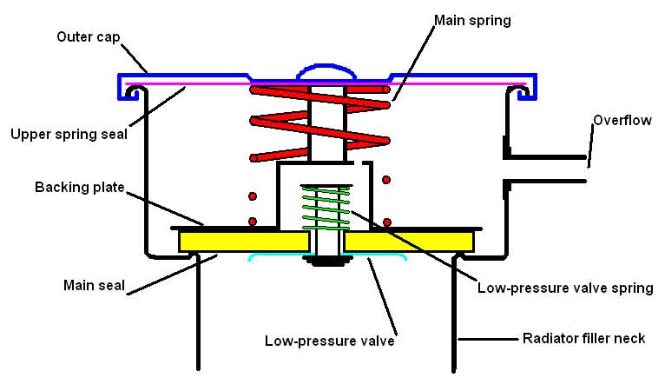
Raditor pressure cap

Slide 18
The thermostat
Regulates enigne coolant temperature
Rated in degrees – 195 degrees most common
Solid Expansion design – wax pellet expands opening at temp increses, valve begins

Slide 19
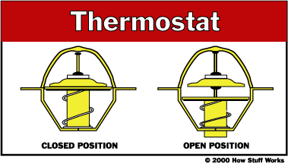
Theromostat

Slide 20
Coolant
Provides freeze and boil over protection, corrosion perventing and good heat transfer .
Ethylene gylcol based – recommended 50/50 mixture with the water , poisonous.
Dex-cool – used by GM, 5 YEAR

Slide 21
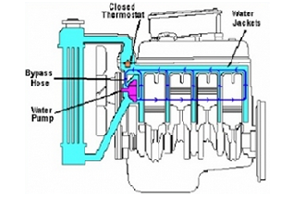
Water jackets
A water jacket is a water-filled casing surrounding a device, typically a metal sheath having intake and outlet vents to allow water to be pumped through and circulated. The flow of water to an external heating or cooling device allows precise temperature control of the device.

Slide 22
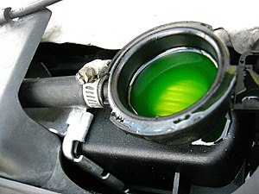
Anti freeze solutions
As well as preventing water from freezing up, antifreeze raises the boiling point of engine coolant to prevent overheating. The stuff also protects your engine from corrosion, aids heat transfer, and prevents scale from building up internally.

Slide 23
Diffrence between air cooling system and water cooling
Air cooling
Water cooling
Air cooling is cheap in price.
Air cooling reduces the weight of vehice.
Air coolinng is often with a forced cooling (fan), because a lot of air is needed to cool down the engine.
Water cooling system is more expensive as compared to air cooling system
Water cooling system is havier and increases the weight of vehicle
With water cooling the liquid is pumped around the engine.

Slide 24
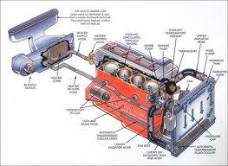
Cooling system

